Slide 1
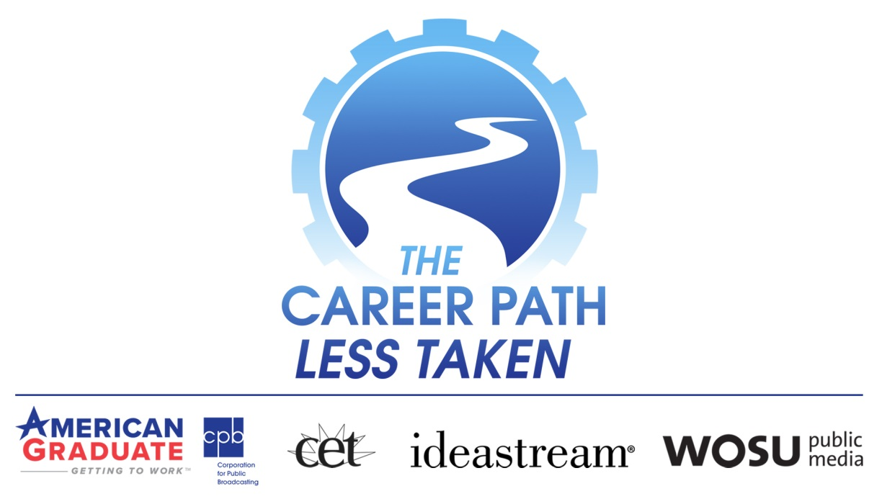
Video Segments + Interactive Q&A
Challenging the Traditional Notions of Success by Demonstrating Many Pathways to Skilled Jobs Do NOT Require a 4-year College Degree
Presented By:
Celena Roebuck, MBA, Ed.D – ideasteam - Community Engagement & Education Manager
Tyler Shinaberry – EPIK - Applied Technology & Workforce Specialist

Slide 2
Celena Roebuck, MBA, Ed.D ; ideastream
With an esteemed background and proven success record of 30+ years in education and a degree in business, Celena was a natural fit to the objectives of CPLT. With an enthusiastic emphasis on the development of powerful career technical programs and curriculum, her leadership has paved the way for CTE.
Built Cuyahoga Valley Career Center into a model that continues to thrive as it services 1,000 high school students; 5,000 adults; and impacts 12,000 K-12 students through its Career Development Program
Past President of the Ohio Association for Career & Technical Education
  Under her guidance began implementing policy direction for legislation
Currently works for Ideastream as the Manager of Educational Content with a primary focus on The Career Path Less Taken directing the initiative to offer clear explanations of intricate data; insights from experts in: education, economics, workforce development, and high-growth industries facing labor shortages. Supplementing the effort, her role strives in aligning Ohio’s education system to the needs of both the workforce and economy
Currently teaches Education Policy and Practice, School Operations & Personnel Management, Leadership for 21st Century Schools, Administration Principles and Practices for the Masters in Educational Leadership and Principal Licensure Programs for the Center for Educational Leadership at Cleveland State University. Within the Monte Ahuja College of Business, Dr. Roebuck teaches World of Business

Slide 3
Tyler Shinaberry - EPIK
Life-long learner with an appreciation of early age education and engagement
Exposed, encouraged, and engaged in numerous aspects of industries with father and grandfather throughout childhood
Denied PSCO option in high school; instead, took machine trades at Tri-Rivers not knowing it was not construction equipment
  Goal was set to learn CNC and teach other students in class and outside
  Began the concept behind EPIK to templatize the process and be a holistic one-stop solution provider for busineses
Became engaged with community objectives for workforce
Took entry level technical and base courses at NCSC but left to pursue business opportunities providing technical support/training for CNC company
Market collapse closed CNC company; placed efforts on keeping orphaned customers in operation
As a solution company was guided that my ideas on workforce shortage were spot on and the true need of my business was for it to go beyond applying the advanced mechatronic, holistic solutions I had in my arsenal, but to create and enable a workforce capable of applying it in industry
Volunteer and paid consultant to numerous organizations focused on bettering their communities, industry sectors, education, and youth/adults who need the opportunity to be empowered and enriched

Slide 4
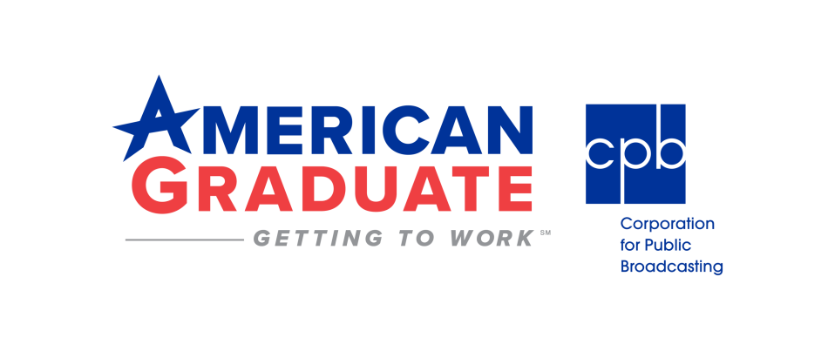
Public media’s long-term commitment made possible by the Corporation for Public Broadcasting
National Effort Covering 17 States & Ohio’s “3Cs”
Purpose is to help young people succeed in school, career, and life
Provides a critical platform to shine a light on pathways to graduating and successful student outcomes
Although graduation rates are at 84.6% nationally, a high school diploma is only the first step toward a future of gainful employment
National effort with organizations like the US Chamber of Commerce Foundation and America’s Promise Alliance to build understanding and awareness, and highlight the solutions driven by schools and businesses
Bringing together of key stakeholders, leaders, and engaged citizens to discuss opportunities and challenges and create compelling LOCAL content with young people sharing their successes as they pursue new careers
Content airs on local channels, online, through social media, and is distributed through partner organizations and the public medica network
Learn More: https://www.cpb.org/americangraduate

Slide 5
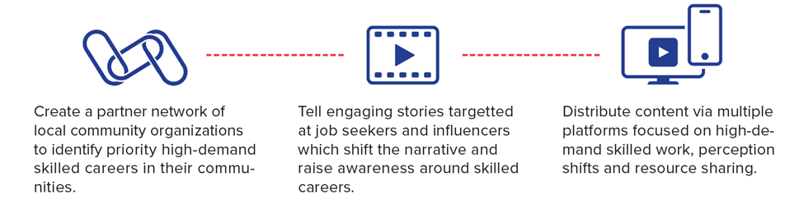

Slide 6
CPB announced a $260,160 statewide collaborative grant under the American Graduate: Getting to Work initiative to help advance education and career readiness locally
Partnership amongst CET; Ideastream; and WOSU to assess workforce challenges and opportunities
Content was produced that focused on the essential skills needs for students and workers to succeed in the job markets of today and tomorrow
Against the backdrop of Ohio’s looming skills gap, The Career Path Less Taken travels across the state to innovative CTE programs that are preparing young people for the jobs of tomorrow and challenges the traditional notions of success by demonstrating that there are many pathways the do not require a four-year college degree
  *While encouraging a career that embraces life-long learning)
Showcases the community and business relationships supporting these opportunities
Learn More: https://www.ideastream.org/education/american-graduate/the-career-path-less-taken

Slide 7
Presentation Breakdown
Quick Poll: What sector do you represent?
  Depending on your perspective/needs, we will choose “2” video segments to share
After each segment, roughly 5 minutes, we will break into a short Q&A about the segment for 10-15 minutes
At the end we will discuss ways to use the program in a lesson plan for educators and as community leaders for businesses/economic groups
Any questions before we start?

Slide 8
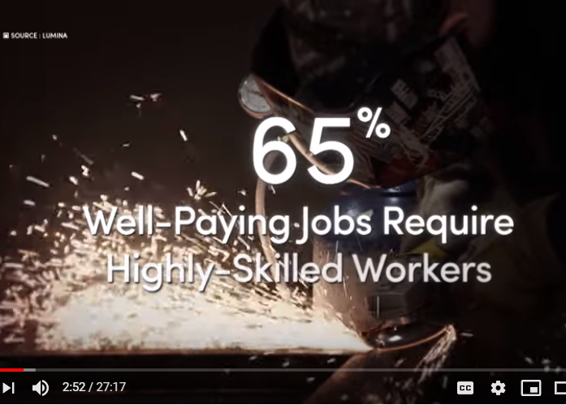
Segment 1 (6:25)
Introduction/Setup & Data Foundations
A visit to the Skills USA Ohio State Championship sets up the topic of 21st Century careers and introduces the current and future “skills gap” faced by the workforce.
[Watch video]

Slide 9
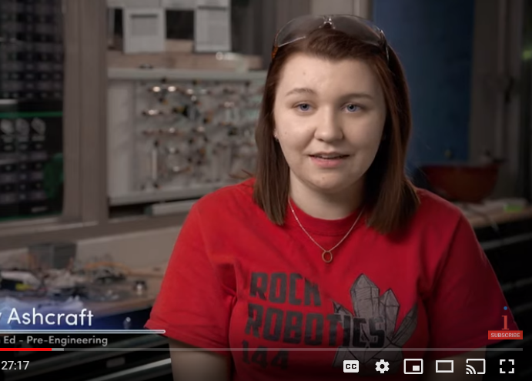
Segment 2 (6:00)
Student Profile: A Pre-Engineering Student
At Colerain High School in Cincinnati, we meet Brittany Ashcraft, a senior, who takes an advanced honors course load, but who is also earning college credit and participating in CTE (pre-engineering) through a Butler Tech satellite program.
[Watch video]

Slide 10
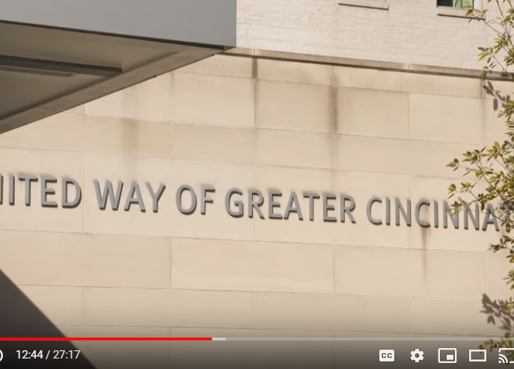
Segment 3 (3:45)
The Role of Business & Industry
We examine how industry and business are finding positive outcomes from aligning and working directly with schools to find, and train, their workers
[Watch video]

Slide 11
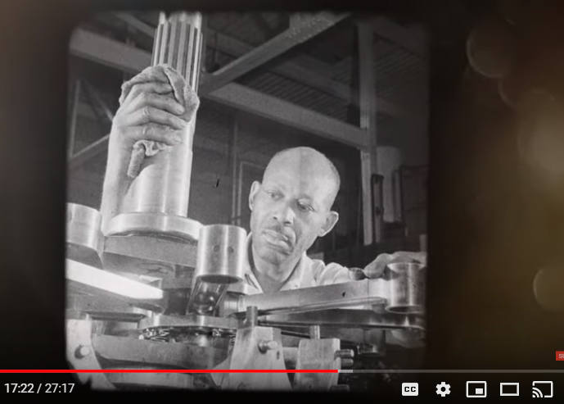
Segment 4 (3:16)
History & Equity of CTE
Dr. Terrence Robinson helps us understand the negative practices (tracking) that have historically been associated with vocational education as we shine a light on the not-so-bright spots of its legacy.
[Watch video]

Slide 12
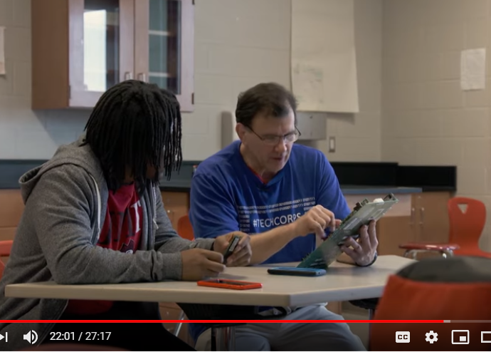
Segment 5 (3:35)
Student Profile: An IT Trainee
At John Marshall School of information Technology in Cleveland, we are introduced to Kobe Ballard, the first student to choose nearly every pathway the school offered—including dual-enrollment at the local community college.
[Watch video]

Slide 13
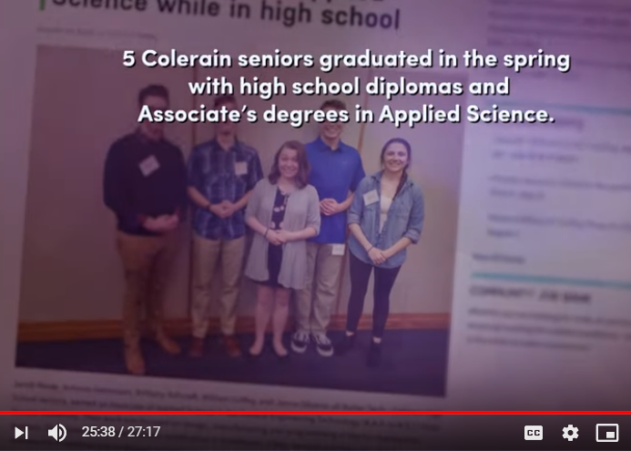
Segment 6 (3:42)
Conclusion & SkillsUSA
We return to the Skills USA Ohio State Competition as winners are announced, reiterating the importance of being clear-eyed about these careers, the need for skilled workers, and why this issue is important for Ohioans, the businesses around the state, and ultimately the state’s economic viability.
[Watch video]

Slide 14
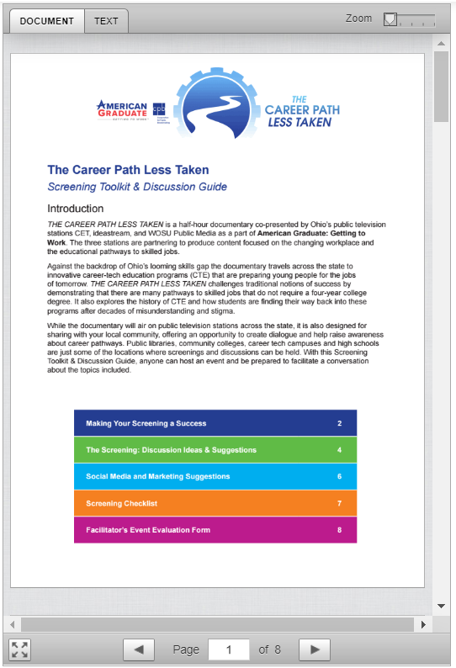
Family, Business, & Community Engagement Resources
(Pre-Packaged Solution)
½ hour complete video broken into relevant sections
Lesson plan for 6th-12th grade
Digital toolkit
  Making Your Screening a Success
  The Screening: Discussion Ideas & Suggestions
  Social Media & Marketing Suggestions
  Screening Checklist
  Facilitator’s Event Evaluation Form
Special “for educators” section explaining myths and actual opportunities
Learn More
Download Toolkit

Slide 15


Thank You for Your Participation!
Celena Roebuck
Community Engagement & Education Manager
Celena.roebuck@Ideastream.org | 216-916-6436
Tyler Shinaberry
Applied Technology & Workforce Specialist
tyler@epikltd.com | 866-928-5167

